Slide 1

E2E Testing & CSS Regression Testing of SPA

Slide 2
How Rajnikanth update facebook status of his new movie?

Slide 3
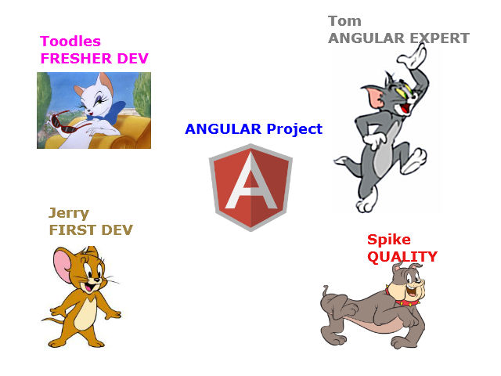
Story - AngularJS SPA project in Sapient

Slide 4
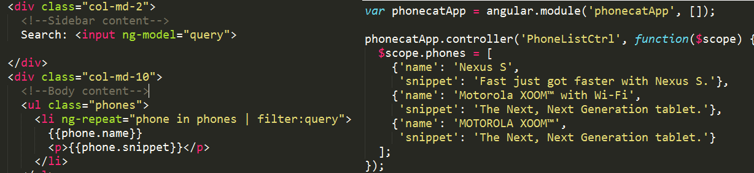
Jerry added the functionalities
Lets see the code in action

Slide 5



Then comes the Angular expert Tom to the team

Slide 6
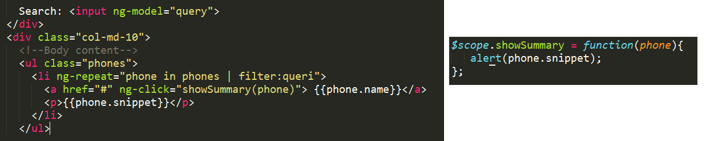
Made the changes and assigned to QA
Lets see the code in action

Slide 7

BUG !! BUG !! BUG !!
What happened? Lets see the code again

Slide 8
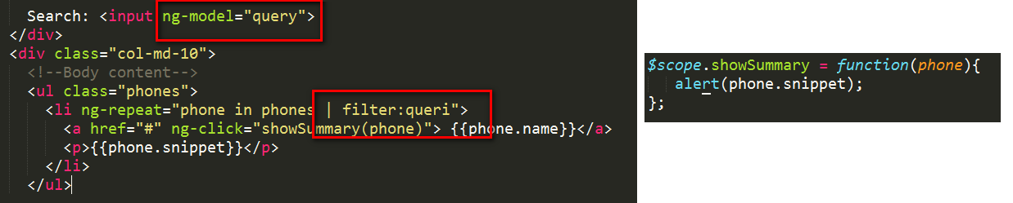

Slide 9
SOLUTION- Manual Testing Before each commit

Slide 10

Feedback - Too slow in implementation

Slide 11


An Angel came in his dreams..

Slide 12
Found a solution!!What Tom did?
Added tests
How? Lets see

Slide 13


Slide 14
What is E2E testing?
Simulates a real user interacting with the system.

Slide 15
WHY End-to-END test?
User testing is expensive and time-consuming.
End-to-end tests can be helpful for identifying or
reproducing quirks that are not caught by integration or unit testing.
Why Not End-to-End Test?
Tests tend to be more brittle, and difficult to write.
Testing asynchronous applications can be difficult.
Protractor tries to address these pitfalls.

Slide 16
What is Protractor?
SELENIUM
+
JASMINE
+
ANGULAR SPECIFIC FUNCTIONALITIES

Slide 17
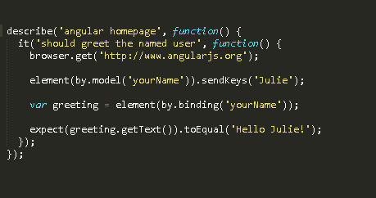
Anatomy of a Test

Slide 18
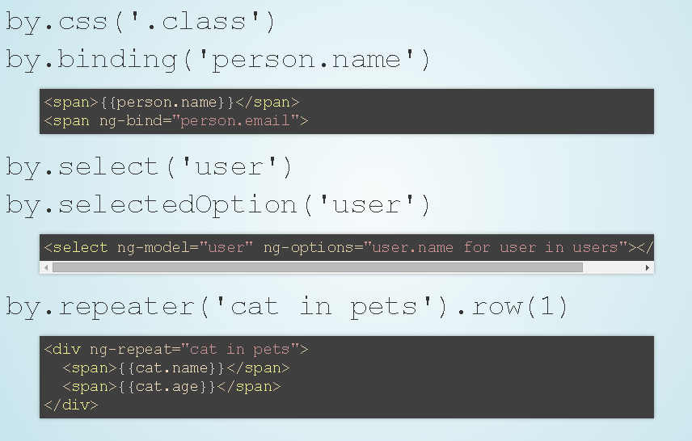
Element Locators

Slide 19
BACK TO OUR STORY

Slide 20

Back to our story
A new member comes to the team - Toodles

Slide 21
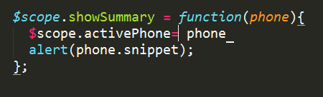
Toodles is a fresher
Got the task to update existing functionality
Sent to Tom for review

Slide 22


Like Humans, Jerry also make mistakes often and the priorities changes

Slide 23
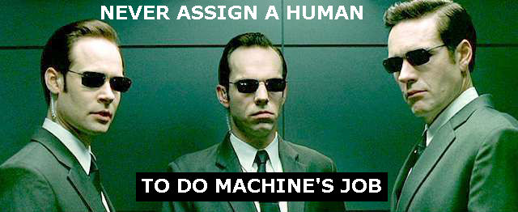
Bad code pass through and it came back after a long time as a bug.

Slide 24
What Tom learned from this?
Before each commit:
Do JavaScript syntax check
JSHINT
Do E2E testing
PROTRACTOR
How do I combine these tasks?

Slide 25

A Task runner

Slide 26
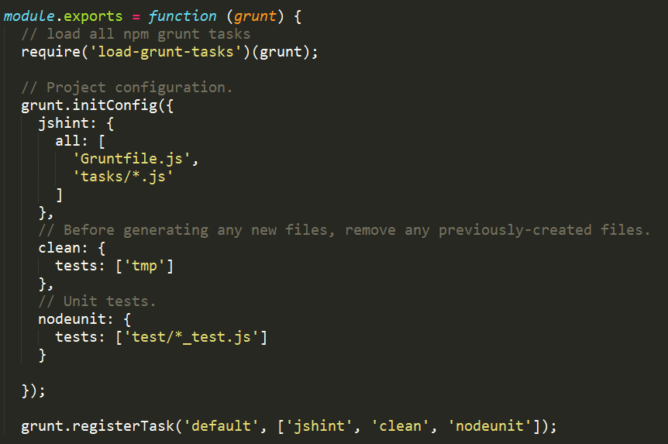

Slide 27

With Grunt to run all these tasks, Tom & Jerry lived happily coded after.

Slide 28
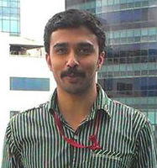
Blog: http://programmerbuddy.blogspot.com
@jintoppy
Jinto Jose

